Slide 1

Predicting Default of Credit Card Clients
Abiola Ijaola
DATA606 Capstone
UMBC

Slide 2

My Background
BSc. Mathematics / Statistics
Over 13 years Experience in Private and Public sector.

Slide 3

Key Terms
Credit Card: This is any financial institution that issues, or causes to be issued, credit cards.
Fraud: This is the crime of gaining money or financial benefits by a trick or by lying.
Risk Control: It is a plan-based business strategy that aims to identify, assess, and prepare for any dangers, hazards, and other potentials for disaster—both physical and figurative—that may interfere with an organization's operations and objectives.
Notes:
Before I go on, I want to define some key domain terms

Slide 4

Why this project ?
The ability to build a predictive model to detect fraudulent activities by mining Department of Information Management, Chung Hua University, Taiwan and Department of Civil Engineering, Tamkang University, Taiwan historical data resources.
In my experience, when evaluating fraudulent transaction, we leverage advanced data science methodologies to identify patterns of fraudulent activities. This is important in measuring risk. Risk metric helps us determine the valuation of companies.
Notes:
The ability to predict bankruptcy is significant for evaluating investment opportunities. Investment professionals want to know if a company will be in continued operation over the long term.

Slide 5

Project Problem Statement
1. The project aims to answer the question - Based on the 23 customers case default payments in Taiwan , what is the;
Probability of default payments
Probability of default among data mining methods
Probability of likelihood of default for its customers, as well as identify the key drivers that determine this likelihood.
2. The project will use Classification algorithms to learn from Taiwan dataset across different forecasting periods.
Notes:
To solve this problem, the project will use classification algorithms to learn from financial statement ratios data from different companies across different forecasting periods.

Slide 6

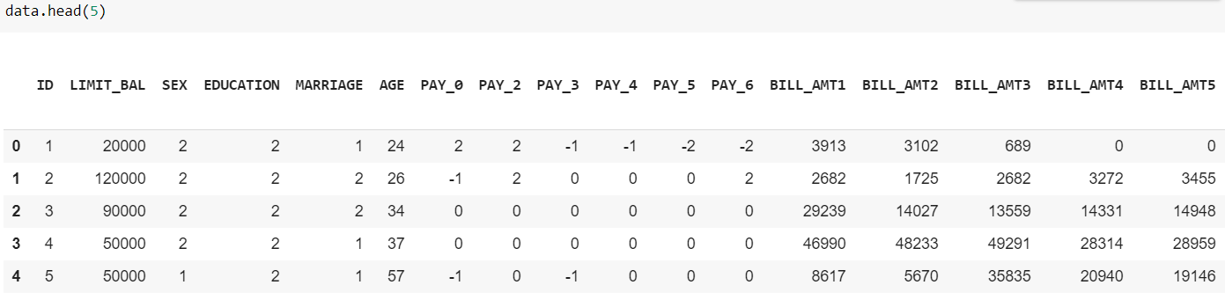
The Data
The dataset is collected from Department of Information Management, Chung Hua University, Taiwan and Department of Civil Engineering, Tamkang University, Taiwan.
The source URLs for the data is
https://archive.ics.uci.edu/ml/datasets/default+of+credit+card+clients.

Slide 7

Methodology
The dataset is a binarily classed multivariate data with 23 features and default payment (Yes = 1, No = 0), as the response variable. From the perspective of risk management, the result of predictive accuracy of the estimated probability of default will be more valuable than the binary result of classification.
Notes:
This is a 5 part process. After sourcing the data, the next step is data cleaning…

Slide 8
Process
Data Cleaning
Deal with Missing Values if any
Define data types for each column
Feature Engineering
Determine most relevant features
Develop synthetic features
Data Visualization
PCA
Determine whether Clusters exist
Model Training
Model Testing, Interpretation, and Evaluation
Choose three most relevant ML algorithms based on data characteristics
For each algo, develop 5 classifiers for the cases
Test and Interpret Models
Evaluate models
Compare Accuracy
Visualize trends and patterns
Understand the dataset

Slide 9

Thank you
Notes:
That’s about it for now. I’ll be posting more videos as the project continues. Thank you for listening.

